Slide 1
第五章
管理Cisco互联网络

Slide 2
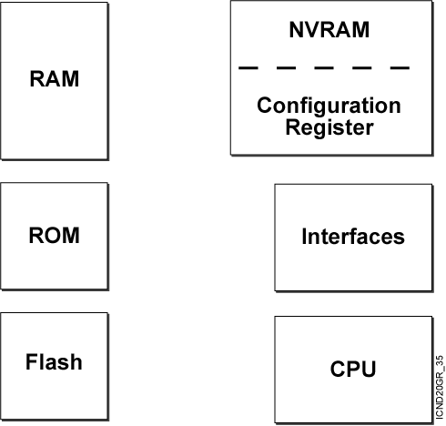
Cisco Router 内部组件
Notes:
Note:
RAM—Packet buffers, running configurations, running Cisco IOS
ROM—POST, ROM monitor, baby Cisco IOS (Rxboot)
NVRAM—Backup configurations, config register
Flash—Cisco IOS
Flash memory is nonvolatile. It behaves like a file system. It is more expensive than NVRAM. It is readable and writeable. The 2500 routers run from Flash. If it is running Cisco IOS from Flash, then the Flash is in the readable state. Use the boot system command to boot Cisco IOS from a TFTP server so the 2500 can run from RAM if you need to write or erase Flash online.

Slide 3
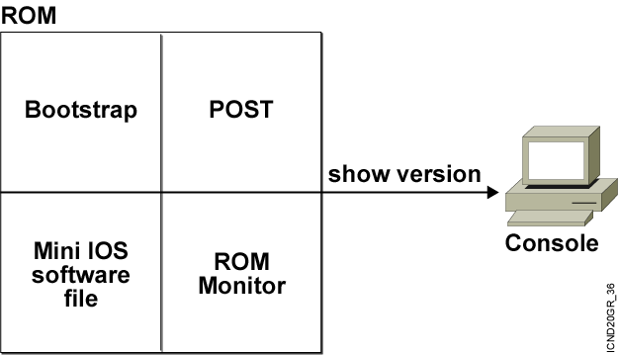
ROM 功能
Notes:
Note: Mini Cisco IOS is the Rxboot mode.
One use of the ROM monitor is for password recovery. From ROM monitor, you can set the config register to 0x2142 so the NVRAM will be ignored during startup.

Slide 4

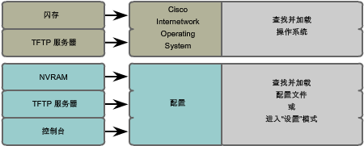
路由器的启动顺序
路由器执行POST开机自检。
Bootstrap查找并加载Cisco IOS软件,默认查找顺序是闪存,TFTP,ROM。
IOS在NVRAM中查找有效的配置文件。
如果有，则复制到RAM中。无，则在以太网口进行广播查找TFTP寻求配置，如果找不到，进入setup

Slide 5
Cisco 配置寄存器
配置寄存器 | 2 |  |  |  | 1 |  |  |  | 0 |  |  |  | 2
位值 | 15 | 14 | 13 | 12 | 11 | 10 | 9 | 8 | 7 | 6 | 5 | 4 | 3 | 2 | 1 | 0
二进制 | 0 | 0 | 1 | 0 | 0 | 0 | 0 | 1 | 0 | 0 | 0 | 0 | 0 | 0 | 1 | 0

Slide 6
查看当前配置寄存器的值
wg_ro_a#show version
Cisco Internetwork Operating System Software
IOS (tm) 2500 Software (C2500-JS-L), Version 12.0(3), RELEASE SOFTWARE (fc1)
Copyright (c) 1986-1999 by cisco Systems, Inc.
Compiled Mon 08-Feb-99 18:18 by phanguye
Image text-base: 0x03050C84, data-base: 0x00001000
ROM: System Bootstrap, Version 11.0(10c), SOFTWARE
BOOTFLASH: 3000 Bootstrap Software (IGS-BOOT-R), Version 11.0(10c), RELEASE SOFTWARE (fc1)
wg_ro_a uptime is 20 minutes
System restarted by reload
System image file is "flash:c2500-js-l_120-3.bin"
--More--
Configuration register is 0x2102
使用show version命令查看
Notes:
Emphasize: Use the show version command to display the value of the config register setting. When you change the config register, you will see the change from the show version output:
Configuration register is 0x2102 (will be 0x2142 at next reload).
The new config register value will be used at the next reload.

Slide 7
修改寄存器命令
Router(config)#config-register 0x2102
>o/r 0x2142 ---→2500
rommon>confreg 0x2142-----→2600

Slide 8
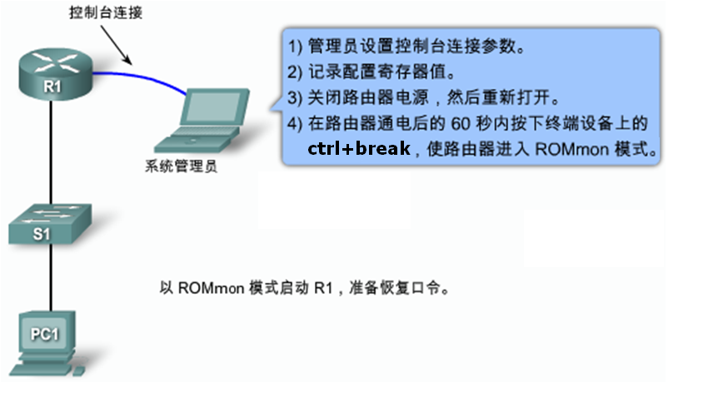
路由器口令破解
Notes:
4.5.7.2

Slide 9
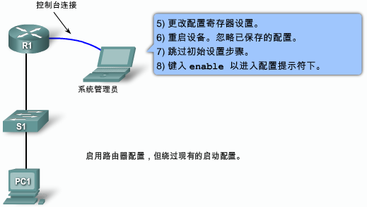

路由器口令破解
Notes:
4.5.7.2

Slide 10
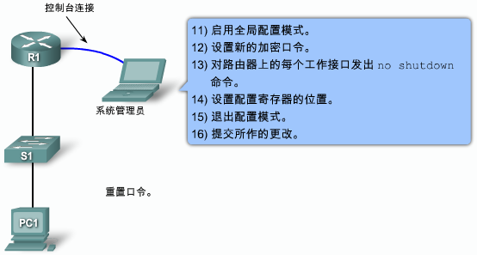
路由器口令破解
Notes:
4.5.7.2

Slide 11
Boot system
闪存坏掉
每次从TFTP启动
闪存中有两个IOS

Slide 12
验证闪存
Router#show version
Cisco Internetwork Operating System Software
IOS (tm) C2600 Software (C2600-JS-M), Version 12.0(7a), RELEASE SOFTWARE (fc1)
Copyright (c) 1986-2002 by cisco Systems, Inc.
Compiled Tue 05-Feb-02 01:48 by pwade
Image text-base: 0x80008088, data-base: 0x80B0404C
ROM: System Bootstrap, Version 11.3(2)XA4, RELEASE SOFTWARE (fc1)
Router uptime is 1 minute
System restarted by reload
System image file is "flash:c2600-js-mz.120-7a.bin"
cisco 2610 (MPC860) processor (revision 0x300) with 53248K/12288K bytes of memory.
Processor board ID JAD06090BMD (2719249260)
M860 processor: part number 0, mask 49
Bridging software.
X.25 software, Version 3.0.0.
SuperLAT software (copyright 1990 by Meridian Technology Corp).
TN3270 Emulation software.
Basic Rate ISDN software, Version 1.1.
1 Ethernet/IEEE 802.3 interface(s)
2 Serial(sync/async) network interface(s)
1 ISDN Basic Rate interface(s)
32K bytes of non-volatile configuration memory.
16384K bytes of processor board System flash (Read/Write)
Configuration register is 0x2102
Notes:
Note: The current state of the Flash memory is in read-only mode. It is running Cisco IOS from Flash.
This router has a total of 16 MB of Flash memory. The Flash contains one Cisco IOS image and there is 6.69 MB of available space left in Flash.

Slide 13
验证闪存
Router#show flash
System flash directory:
File Length Name/status
1 10084696 c2500-js-l_120-3.bin
[10084760 bytes used, 6692456 available, 16777216 total]
16384K bytes of processor board System flash (Read ONLY)
Notes:
Note: The current state of the Flash memory is in read-only mode. It is running Cisco IOS from Flash.
This router has a total of 16 MB of Flash memory. The Flash contains one Cisco IOS image and there is 6.69 MB of available space left in Flash.

Slide 14
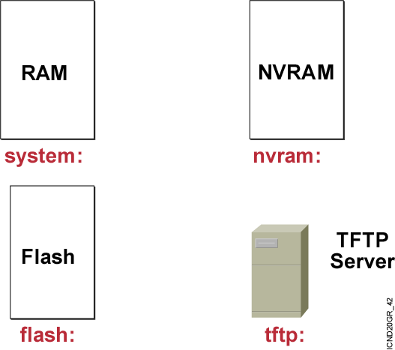
Cisco IOS 文件系统与设备
Notes:
Emphasize: In Cisco IOS Release 12.0, there are new copy commands. These new commands treat the RAM, Flash, NVRAM, TFTP, FTP, and so on as a file system. Since this class was developed when the most common Cisco IOS in the field is pre-12.0, these 12.0 commands are not covered in detail in this class.

Slide 15
IFS命令
dir
copy
more
show file
delete
erase/format
cd/pwd
mkdir/rmdir

Slide 16
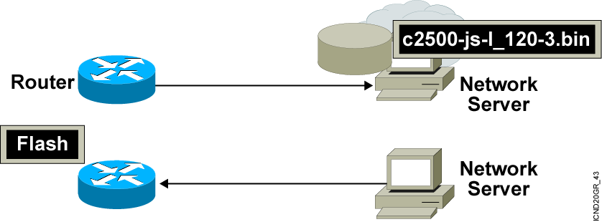
管理Cisco IOS 镜像
Notes:
Emphasize: This section introduces topics on managing your configuration file and Cisco IOS image.

Slide 17
检查闪存中的镜像文件
wg_ro_a#show flash
System flash directory:
File Length Name/status
1 10084696 c2500-js-l_120-3.bin
[10084760 bytes used, 6692456 available, 16777216 total]
16384K bytes of processor board System flash (Read ONLY)
  Verify that flash memory has room for the
  Cisco IOS image.
Notes:
Emphasize: The show flash command is an important tool to use to gather information about your router memory and image file. Caution students that they must know that they are loading the correct and appropriate image. The name for the Cisco IOS image file contains multiple parts, each with a specific meaning:
The first part of the image name contains the platform on which the image runs. In this example, the platform is C2500.
The second part of the name identifies the special capabilities of the image file. A letter or series of letters identifies the feature sets supported in that image. In this example, the “j” indicates this is an enterprise image, and the “s” indicates it contains extended capabilities.
The third part of the name specifies where the image runs and if the file is compressed. In this example, “l” indicates the file is relocatable and not compressed. Relocatable means the Cisco IOS can be run from Flash or from RAM. You should be careful in reading the Cisco IOS image filename. Some fonts display the lowercase letter “l” and the number 1 as the same character. How you enter the characters will impact the ability of the router to load the files correctly.
The fourth part of the name indicates the version number. In this example, the version number is 12.0 (3).
The final part of the name is the file extension. The .bin extension indicates this file is a binary executable file.
The Cisco IOS software naming conventions, name part field meaning, image content, and other details are subject to change. Refer to Cisco Connection Online (CCO) for updated details.

Slide 18
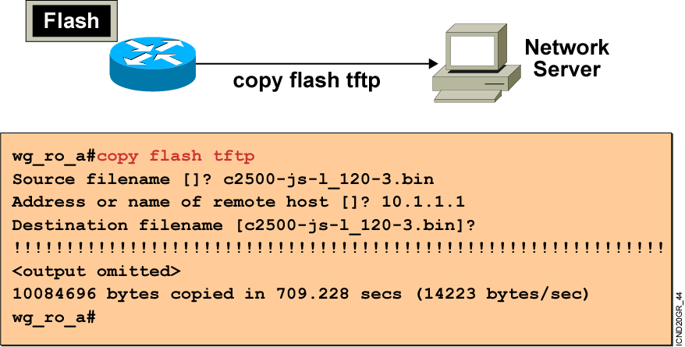
备份和升级 软件映像
升级之前需要先备份原来的镜像.
Notes:
Purpose: This slide discusses how to create a backup version of a Cisco IOS software image to a TFTP server.
Emphasize: Routers by default come with Flash memory that has a preloaded copy of the Cisco IOS software. Although Flash is extremely reliable—good for 65 years and 100,000 rewrites—it is a good idea to make a backup copy of the Cisco IOS software if you have a TFTP server available. If you have to replace Flash memory for some reason, you will have a backup copy at the revision level currently running on your network.
The copy command screen output varies depending on the Cisco IOS software level.
Determine the platform type of your TFTP server prior to beginning the backup procedure. The TFTP server may be running Windows, UNIX, Mac, or other OS. Filename and directory access procedures may vary depending on the TFTP server platform and platform version.

Slide 19
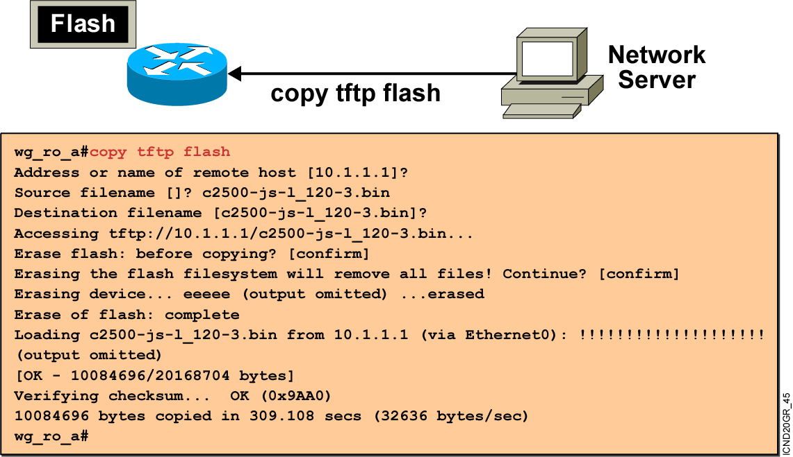
升级镜像文件
Notes:
Purpose: This slide describes how to load a backup version of a Cisco IOS software image from a TFTP server to the router.
Emphasize: If you need more Flash space to load a copy of the Cisco IOS software, you must first erase the Flash memory. You cannot erase a single image—you must erase all copies of Cisco IOS software from Flash. However, if Flash memory on the router is partitioned, you can erase one or more of the parts.
After the TFTP transfer is completed, use the show flash command to view the file size to compare its size with that of the original on the server.
If the Cisco IOS is running from Flash, then the Flash is in the read-only state. To change the Flash to a writeable state, you can use the boot system TFTP command to boot a Cisco IOS from a TFTP server and the Cisco IOS will be run from RAM, or you can go to the Rxboot mode to perform the copy.

Slide 20
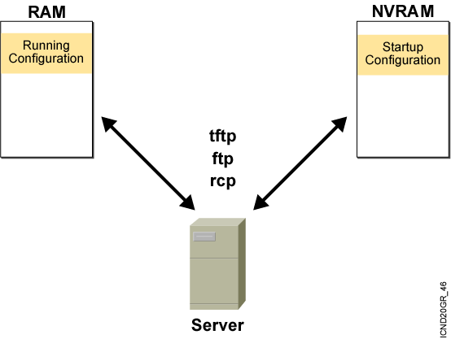
设备配置文件

Slide 21
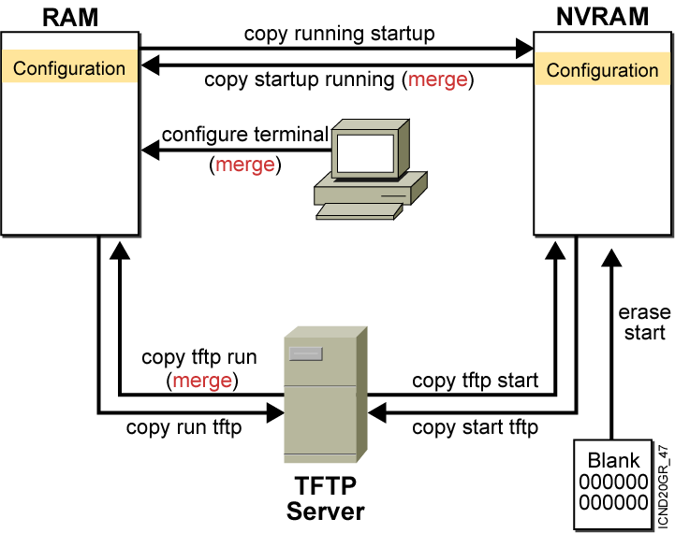
Cisco IOS copy 命令
  NVRAM
  Terminal
  TFTP server
  Erase start
Notes:
Layer 4 of 4

Slide 22
Cisco IOS copy命令举例
running-config
TFTP Server saved.cfg
interface s0
ip address 10.1.1.1 255.255.255.0
interface e0
ip address 10.2.2.2 255.255.255.0
interface e1
no ip address
interface e0
ip address 172.16.1.1 255.255.255.0
interface e1
ip address 192.168.1.1 255.255.255.0
copy tftp run (merged)
interface s0
ip address 10.1.1.1 255.255.255.0
interface e0
ip address 172.16.1.1 255.255.255.0
interface e1
ip address 192.168.1.1 255.255.255.0
Resulting
running-config
Notes:
Note: Cisco IOS Release 12.0 supports a new syntax for the copy command.

Slide 23
copy run tftp 和copy tftp run 命令
wg_ro_a#copy running-config tftp
Address or name of remote host []? 10.1.1.1
Destination filename [running-config]? wgroa.cfg
.!!
1684 bytes copied in 13.300 secs (129 bytes/sec)
wg_ro_a#copy tftp running-config
Address or name of remote host []? 10.1.1.1
Source filename []? wgroa.cfg
Destination filename [running-config]?
Accessing tftp://10.1.1.1/wgroa.cfg...
Loading wgroa.cfg from 10.1.1.1 (via Ethernet0): !
[OK - 1684/3072 bytes]
1684 bytes copied in 17.692 secs (99 bytes/sec)
Notes:
Note: Cisco IOS Release 12.0 supports a new syntax for the copy command.

Slide 24
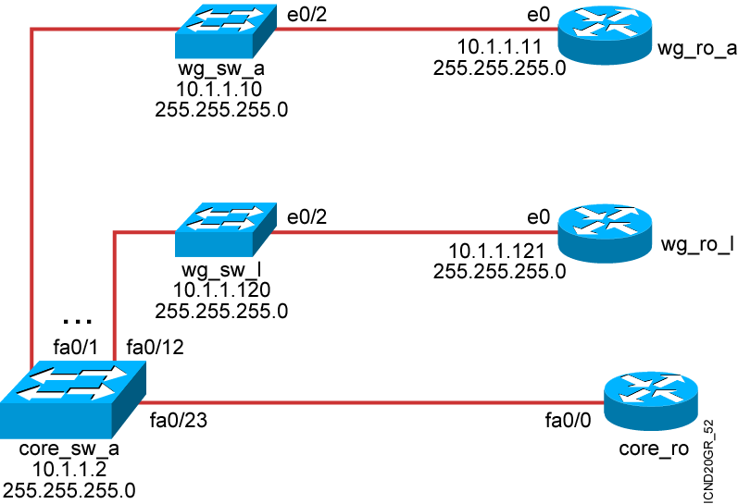
使用Cisco发现协议
Cisco发现协议(Cisco Discovery Protocol)是由Cisco设计的专用协议。通过使用CDP，可以收集相邻设备的硬件和协议信息，对于故障诊断和网络文件归档很有用。

Slide 25
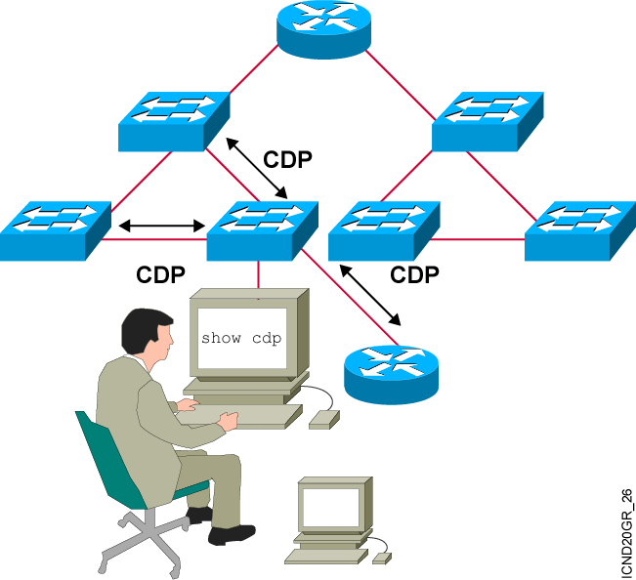
使用CDP发现邻居
CDP 运行在 Cisco IOS®
10.3 及以上版本的路由器，交换机，集线器上.
总结信息包括:
  设备标识符
  地址列表
  端口标识符
  Capabilities list
  Platform
Notes:
Emphasize: CDP is media- and protocol-independent and runs on all Cisco-manufactured equipment including routers, access servers, switches, and some managed hubs. With CDP, network management applications can retrieve the device type and SNMP agent address of neighboring devices. This capability enables applications to send SNMP queries to neighboring devices.
CDP allows network management applications to dynamically discover Cisco devices that are neighbors. CDP runs on all media that support the Subnetwork Access Protocol, including LAN and Frame Relay. CDP runs over the data link layer only, not the network layer. Therefore, two systems that support different network-layer protocols can learn about each other.
Cached CDP information is available to network management applications. Cisco devices never forward a CDP packet. When new information is received, old information is discarded. The holdtime determines how long to keep existing information from a neighbor.

Slide 26
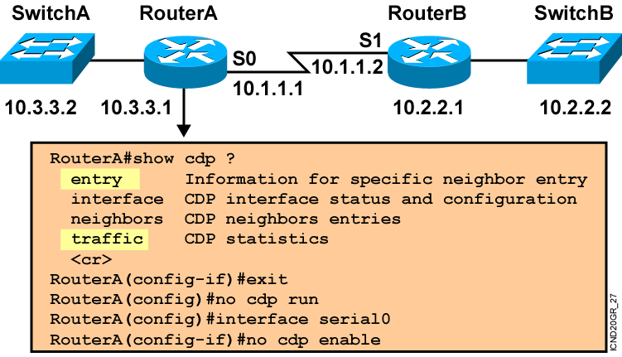
使用 CDP
Notes:
Note: Some of the CDP commands are not available on the Catalyst 1900 switch, like cdp run, show cdp traffic, and show cdp entry.

Slide 27
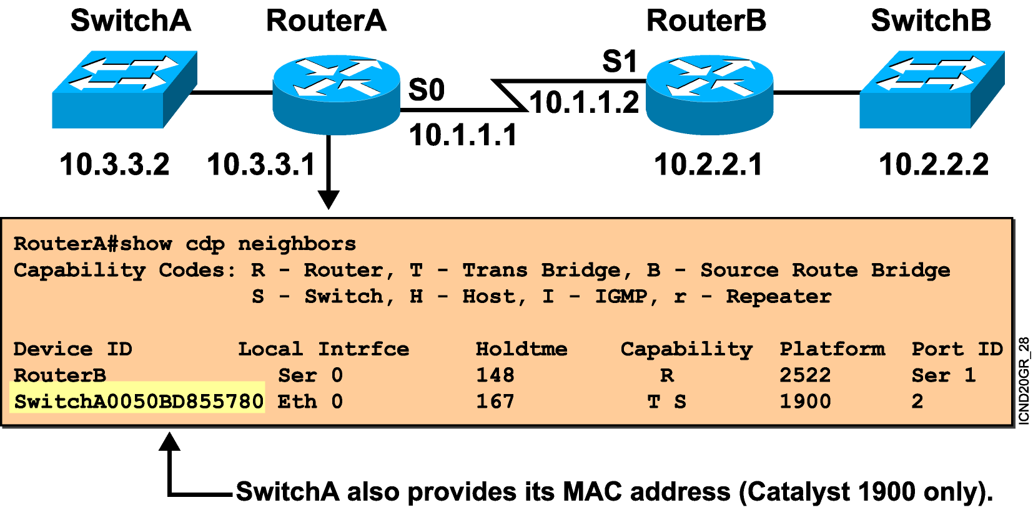
使用 show cdp neighbors 命令
Notes:
Emphasize: This graphic shows the show cdp neighbors command initiated from a router, which displays a summary of the capabilities and access details for the CDP neighbors. The show cdp neighbors detail command shows detailed information about the same devices.
Note: If the neighbor is a Catalyst 1900 switch, the switch MAC address is also displayed. If the switch is a 2900xl, its MAC address is not displayed.

Slide 28
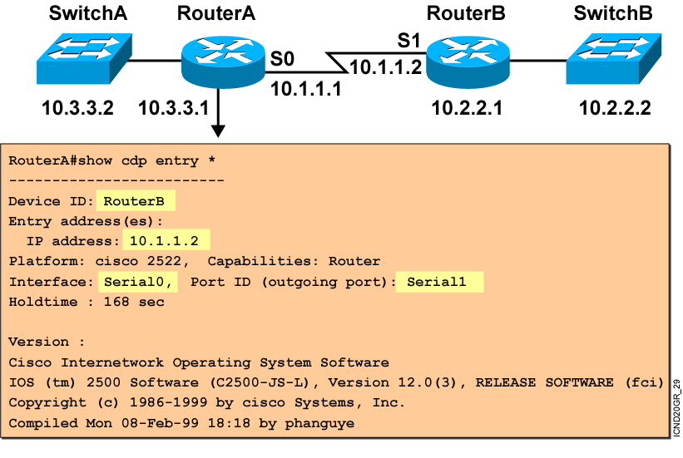
使用 show cdp entry命令
Notes:
Emphasize: The example shows what information can be obtained about RouterA’s neighbor. CDP is one way to learn about other Cisco devices on the network.

Slide 29
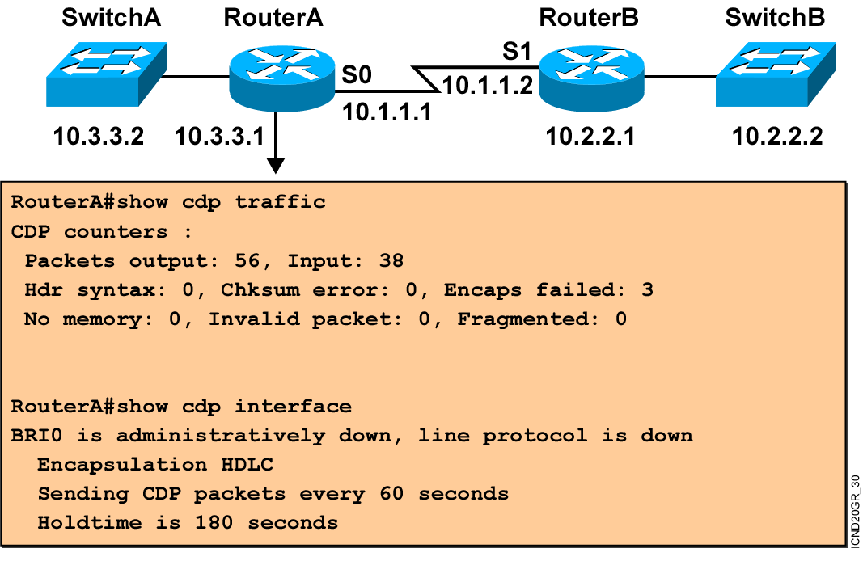
其他 CDP 命令
Notes:
Note: The holdtime indicates how long the neighbor information will be kept in the local CDP table.

Slide 30
使用CDP命令记录网络拓扑结构

Slide 31
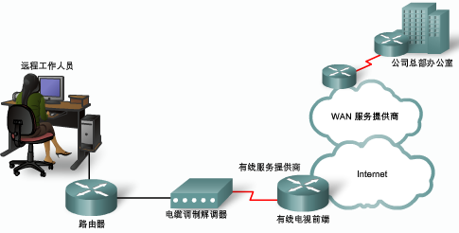
telnet使用
telnet到多台设备 按下crtl+shift+6,松开后再按下X键
检查telnet连接 :show sessions
重新连接会话：resume num 或直接输入num
检查telnet用户 :show users
关闭telnet会话：disconnect num
踢出登录用户 ：clear line num

Slide 32
解析主机名
ip host
show hosts
ip name-server
ip domain-lookup

Slide 33
show process
查看CPU利用率，进程情况。

Slide 34
结束

